Slide 1
Detecting Indications for recovery from coma System with OpenCV and Keras
DEEP LEARNING
PROJECT
presented by: Tahani Alqahtani, Amani Albalawi

Slide 2
INTRODUCTION
1
2
ABOUT DATA
ABOUT MODEL
3
4
CONCOLOSION

Slide 3

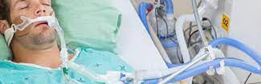
introduction
With this Python project, we will be making a model detection system.
helps to detect if patient opening eyes, where the doctors give
a warning that the patient has opened his eyes.
So, to detect this case we will build a system using Python, OpenCV, and Keras which will alert the doctor when patient he opened his eyes.

Slide 4

About Data:
Size : +1400 image
cateogries
open and closed eyes

Slide 5
Data augmentation
performing transfer learning
Preparing Base Model
Rescale pixel values

Slide 6

Performing Transfer Learning
1
Transfer Learning
(MobileNet V2 model)
2
Freezing the pre-trained
MobileNet V2
3
Compilation of the model
4
Fitting the Dataset
into the Model

Slide 7
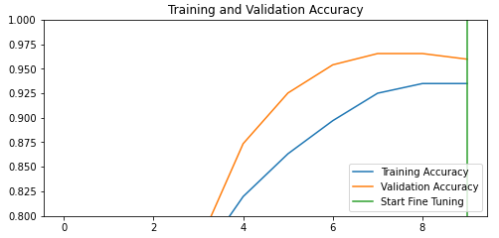
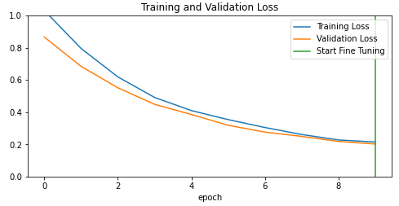
Modelling:
mobilenetv2
*optimizer= Adam
*initial_epochs = 10
Test accuracy : 0.984375
Train accuracy : 0.96622
Validation accuracy : 0.9598

Slide 8
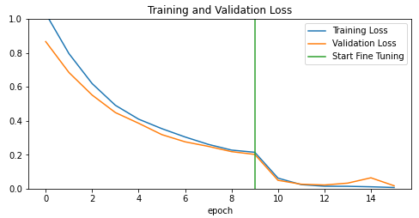
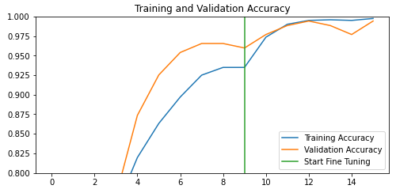
Model with fine tunning:
mobilenetv2
*optimizer= RMSprop
*initial_epochs = +5
Test accuracy : 0.9975
Train accuracy : 0.9975
Validation accuracy : 0.9942528605461121

Slide 9
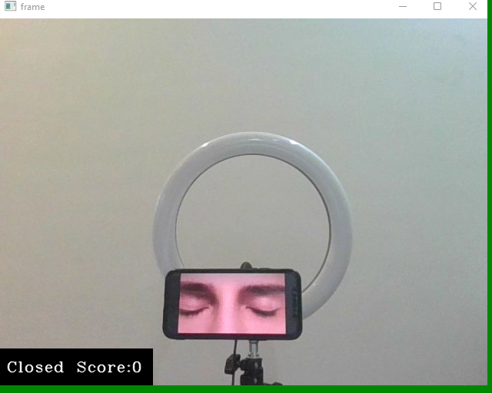
Concolusion

Slide 10
Thank you for listening
Tahani Alqahtani
Amani Albalawi
?
______________________
Question Time

